Slide 1
UNIT-2 Software Quality and Reliability

Slide 2
Importance of Software Quality and Timely Availability

Slide 3

Software Quality
Definition:
The totality of functionality and features of a software product that bear on its ability to satisfy stated needs.

Slide 4
Software Quality
Methods to Achieve Quality
Define characteristics that define quality for a product.
Decide how to measure each of that quality characteristic.
Set standards for each quality characteristic.
Do quality control with respect to the standards.
Find out the reasons that are hindering quality.
Make necessary improvements.

Slide 5
Software Quality Attributes
Quality Attributes:
Correctness, Reliability, Adequacy, Learnability, Robustness, Maintainability, Readability, Extensibility, Testability, Efficiency, Portability
Correctness
Agreement of program code with specifications.
Independence of the actual application of the software system

Slide 6
Software Quality - Attributes
Reliability
Reliability of a software system is defined as the probability that this system fulfills a function (determined by the specifications) for a specified number of input trials under specified input conditions in a specified time interval (assuming that hardware and input are free of errors).
A software system can be seen as reliable if this test produces a low error rate.

Slide 7
Software Quality Attributes
Factors for the requirement of Adequacy
The input required of the user should be limited to only what is necessary
The software system should expect information only if it is necessary for the functions that the user wishes to carry out
should enable flexible data input on the part of the user and should carry out plausibility checks on the input

Slide 8
Software Quality - Attributes
The results produced by the software system
The results that a software system delivers should be output in a clear and well structured form and be easy to interpret
Learnability depends on
The design of user interfaces The clarity and the simplicity of the user instructions (tutorial or user manual).
The user interface should present information as close to reality as possible and permit efficient utilization of the software’s failures.

Slide 9
Software Quality - Attributes
Robustness
Robustness reduces the impact of operational mistakes, erroneous input data, and hardware errors.
Frequent errors (e.g. erroneous commands, typing errors) must be handled with particular care.
Less frequent errors (e.g. power failure) can be handled more laxly, but still must not lead to irreversible consequences.

Slide 10

Software Quality - Attributes
Maintainability: Maintainability = suitability for debugging (localization and correction of errors) and for modification and extension of functionality.
The maintainability of a software system depends on its:
Readability
Extensibility
Testability

Slide 11
Software Quality - Attributes
Readability: Readability of a software system depends on its:
Form of representation
Programming style
Consistency
Extensibility: Extensibility allows required modifications at the appropriate locations to be made without undesirable side effects. Extensibility of a software system depends on its:
Structuredness (modularity) of the software system
Possibilities that the implementation language provides for this purpose

Slide 12
Software Quality - Attributes
Testability: suitability for allowing the programmer to follow program execution (runtime behavior under given conditions) and for debugging.
The testability of a software system depends on its:
Modularity
Structuredness
Efficiency: ability of a software system to fulfill its purpose with the best possible utilization of all necessary resources
(time, storage, transmission channels, and peripherals)

Slide 13
Software Quality - Attributes
Portability: the ease with which a software system can be adapted to run on computers other than the one for which it was designed.
The portability of a software system depends on:
Degree of hardware independence.
Implementation language.
Extent of exploitation of specialized system functions.
Hardware properties.

Slide 14
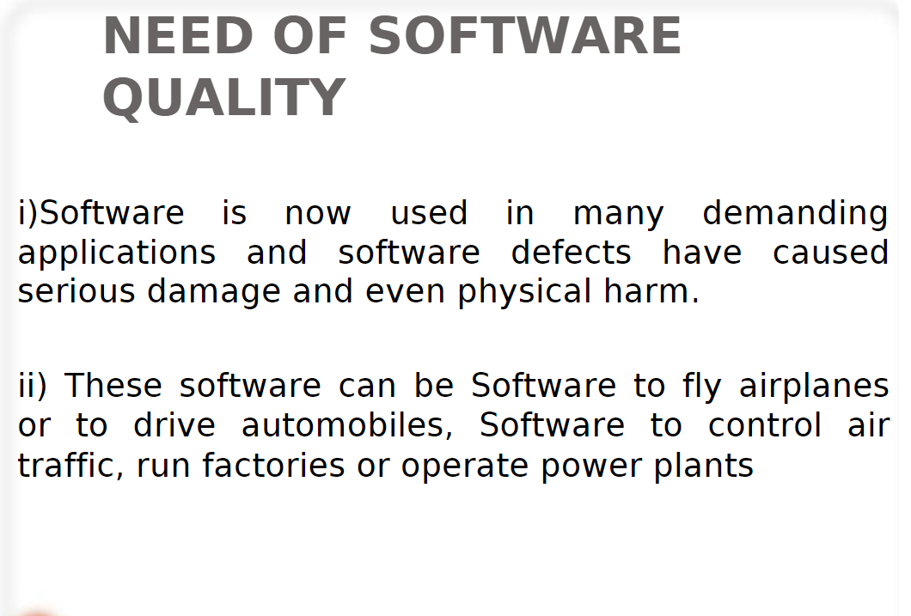

Slide 15
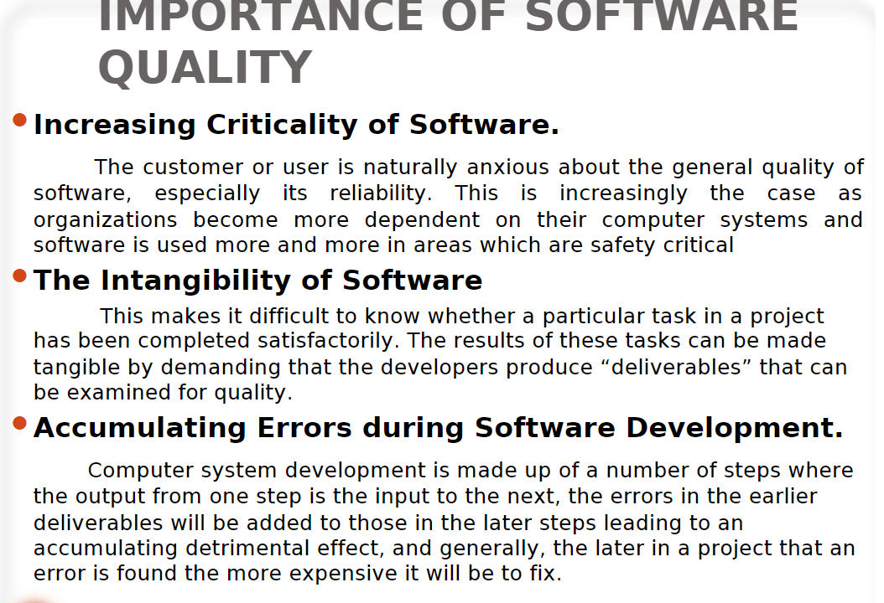

Slide 16
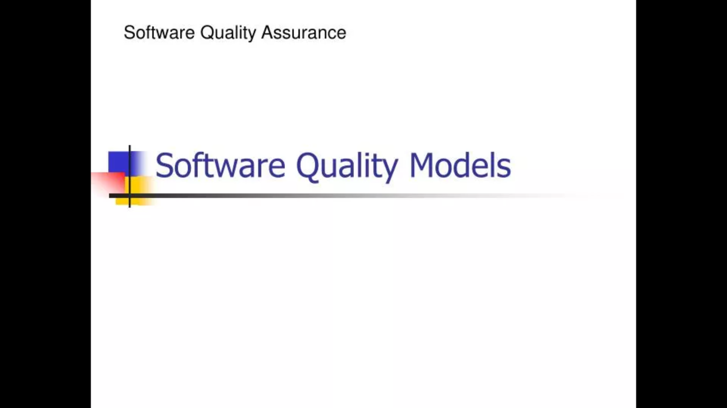

Slide 17
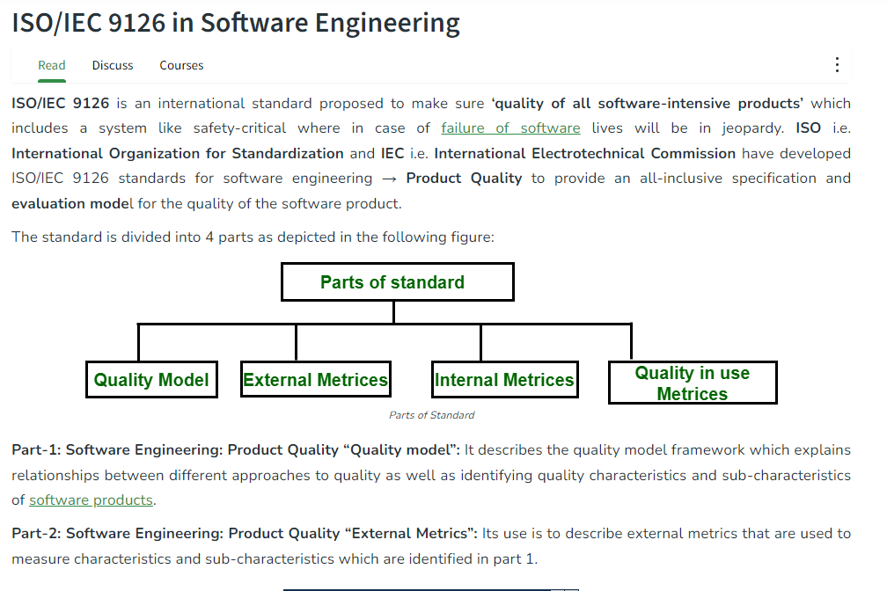

Slide 18
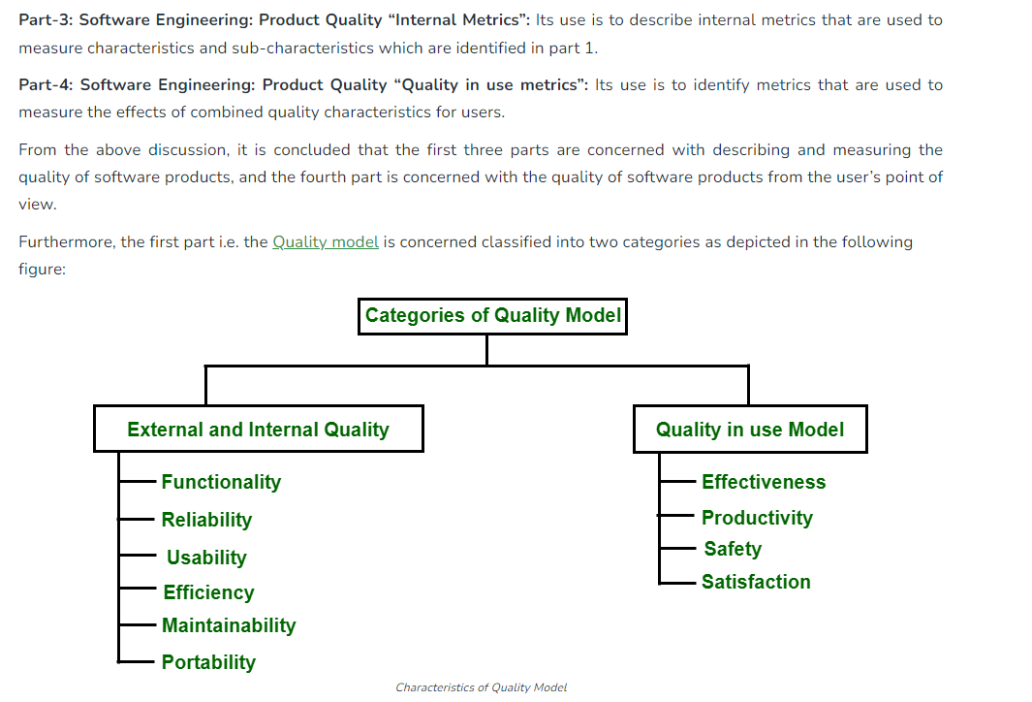

Slide 19
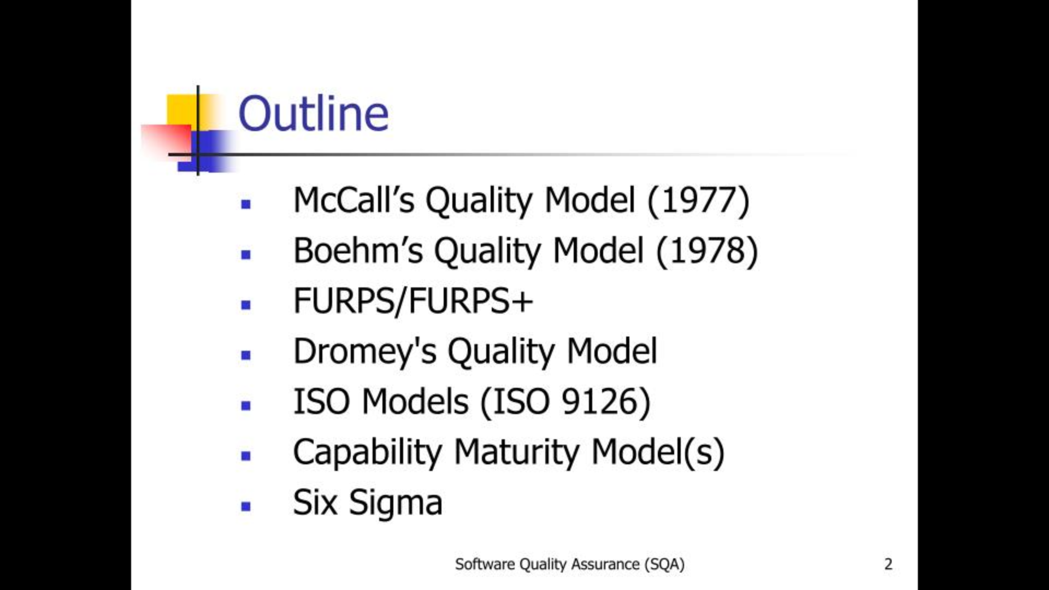

Slide 20
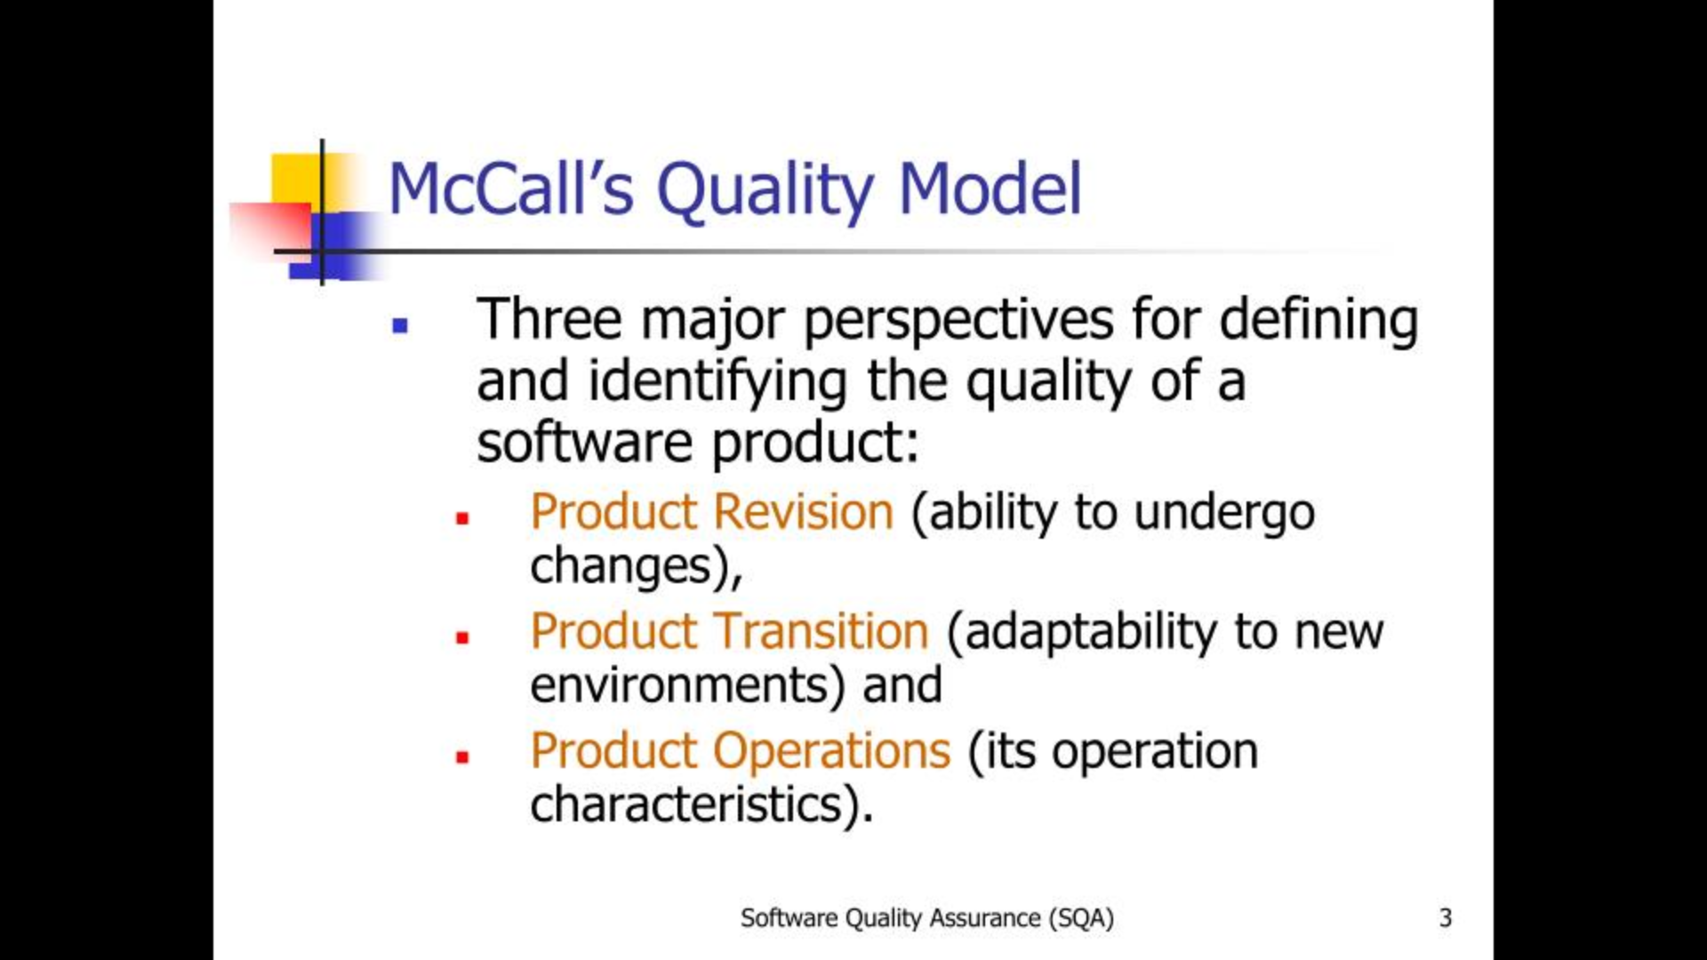

Slide 21
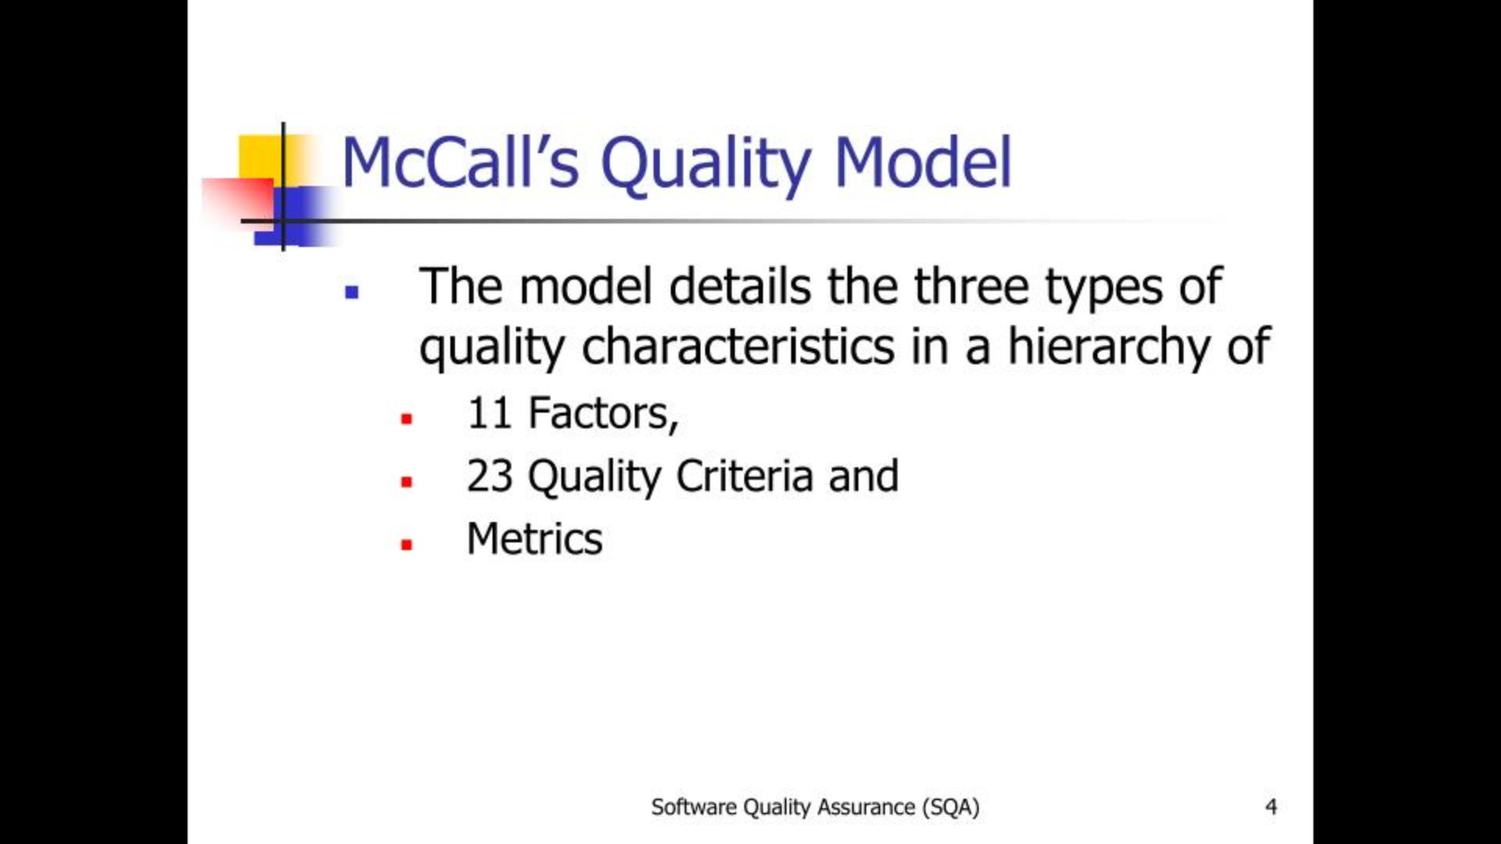

Slide 22
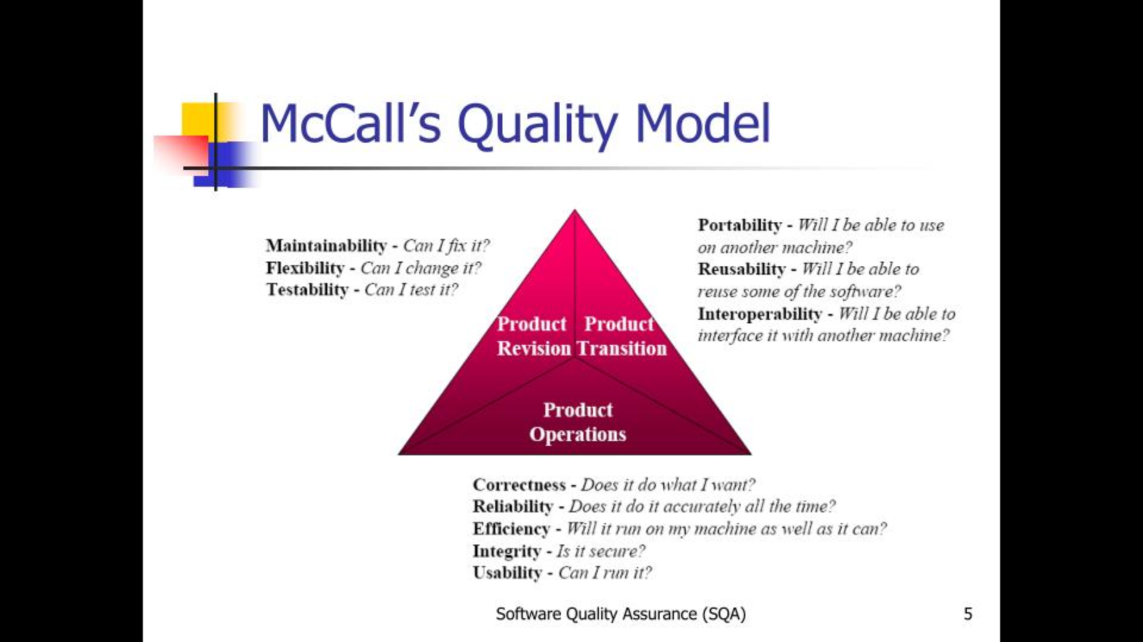

Slide 23
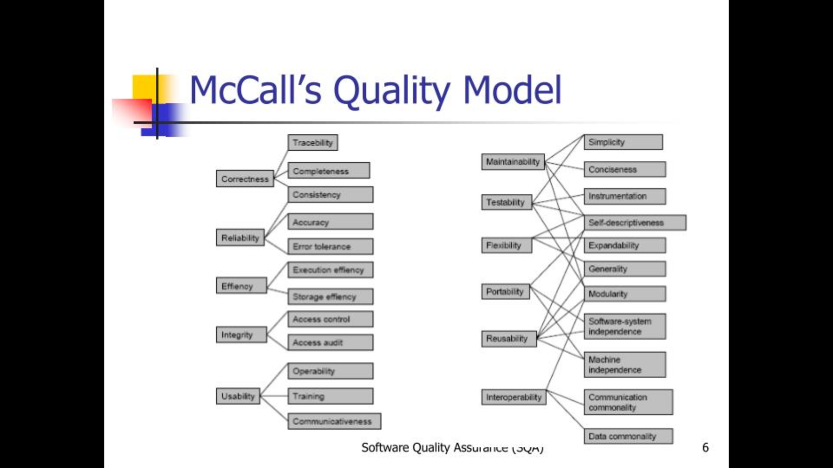

Slide 24
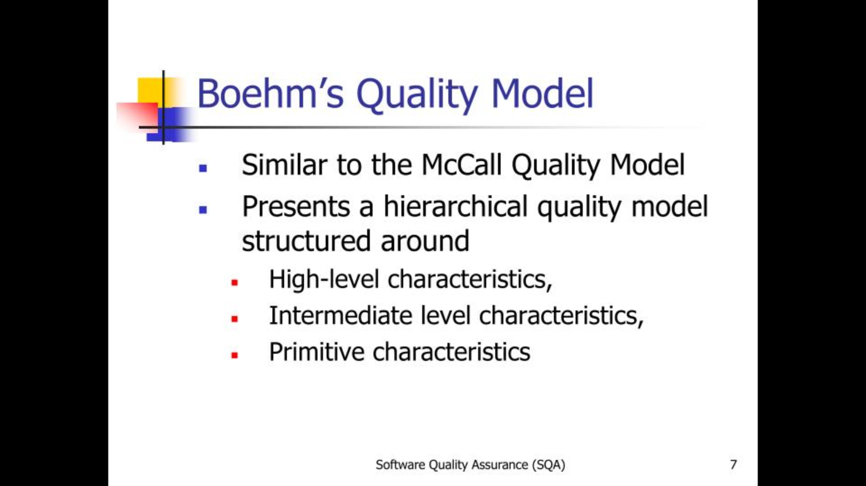

Slide 25
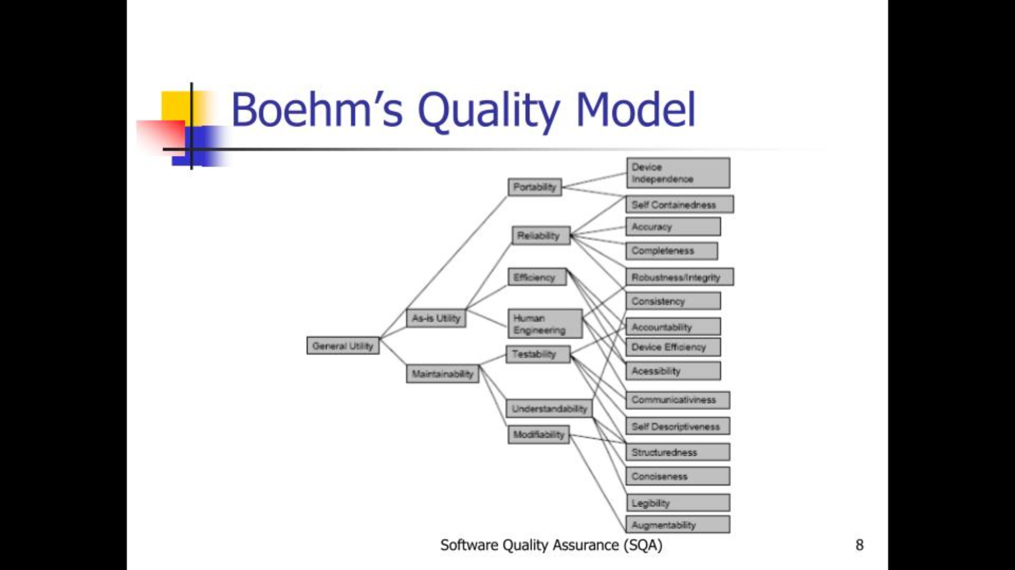

Slide 26
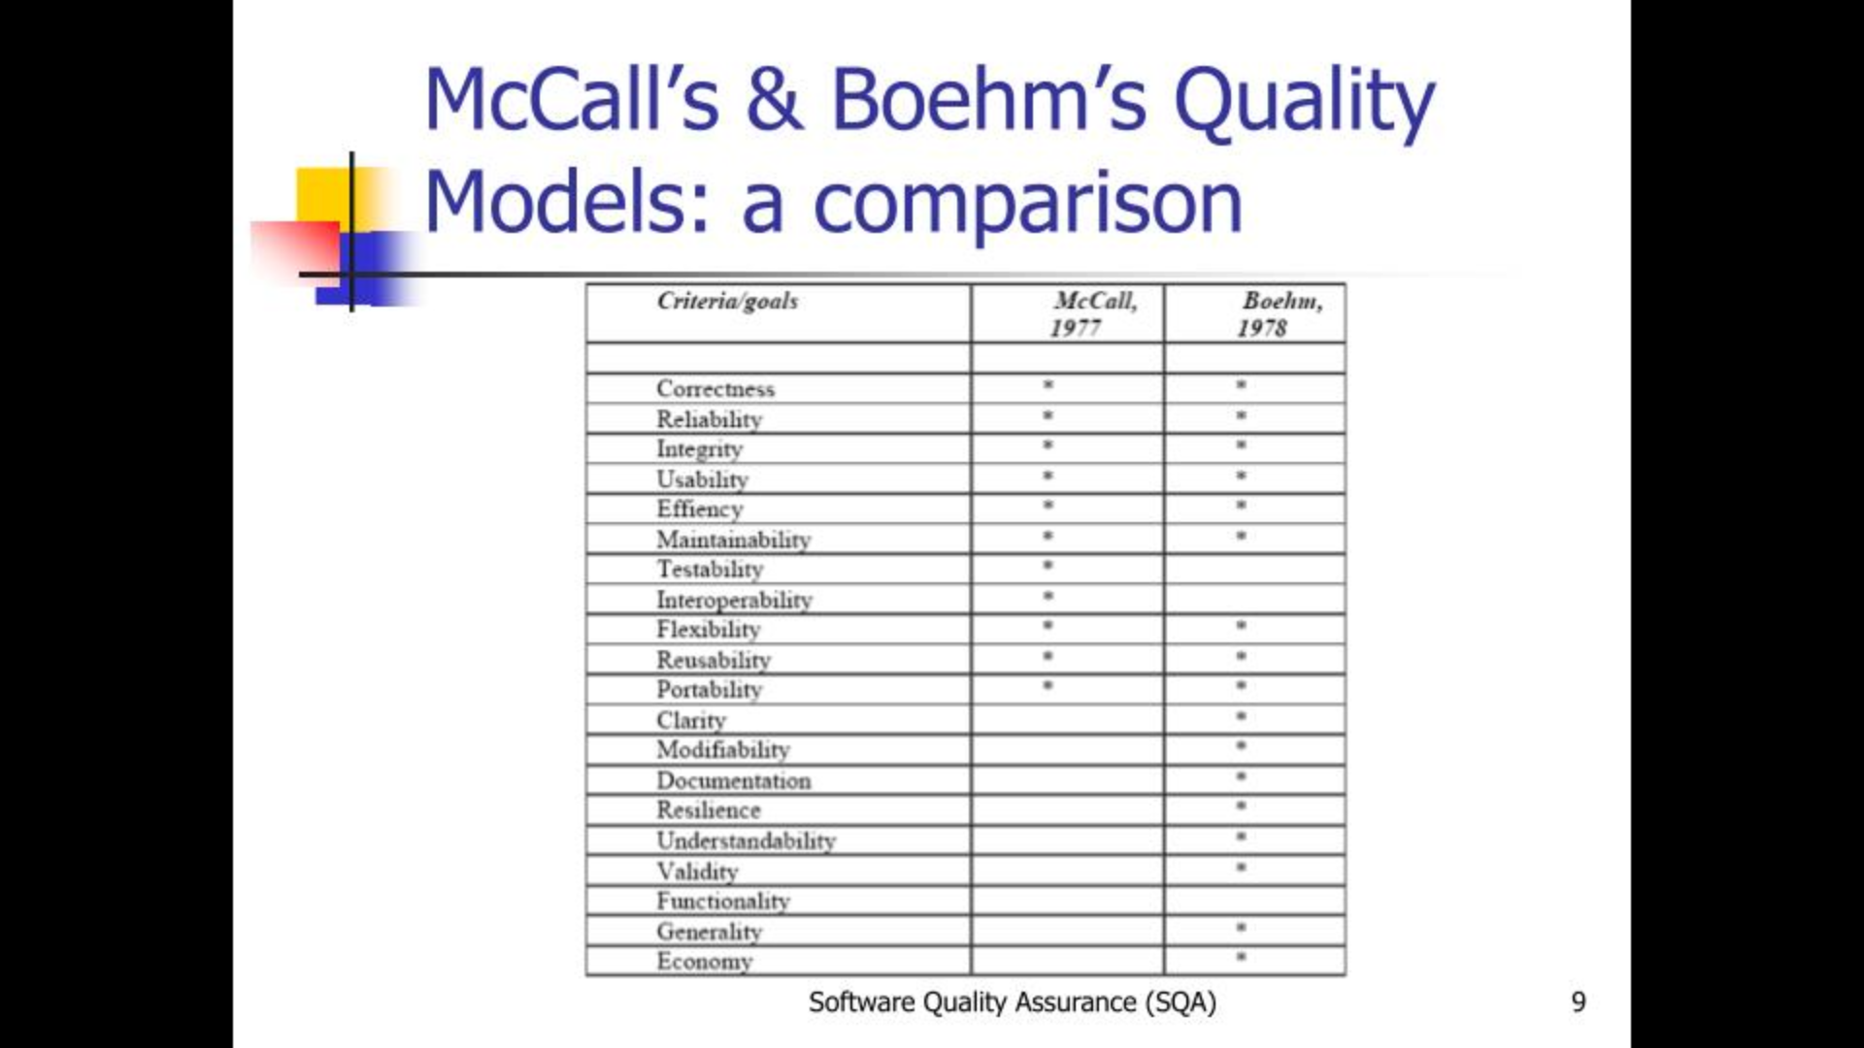
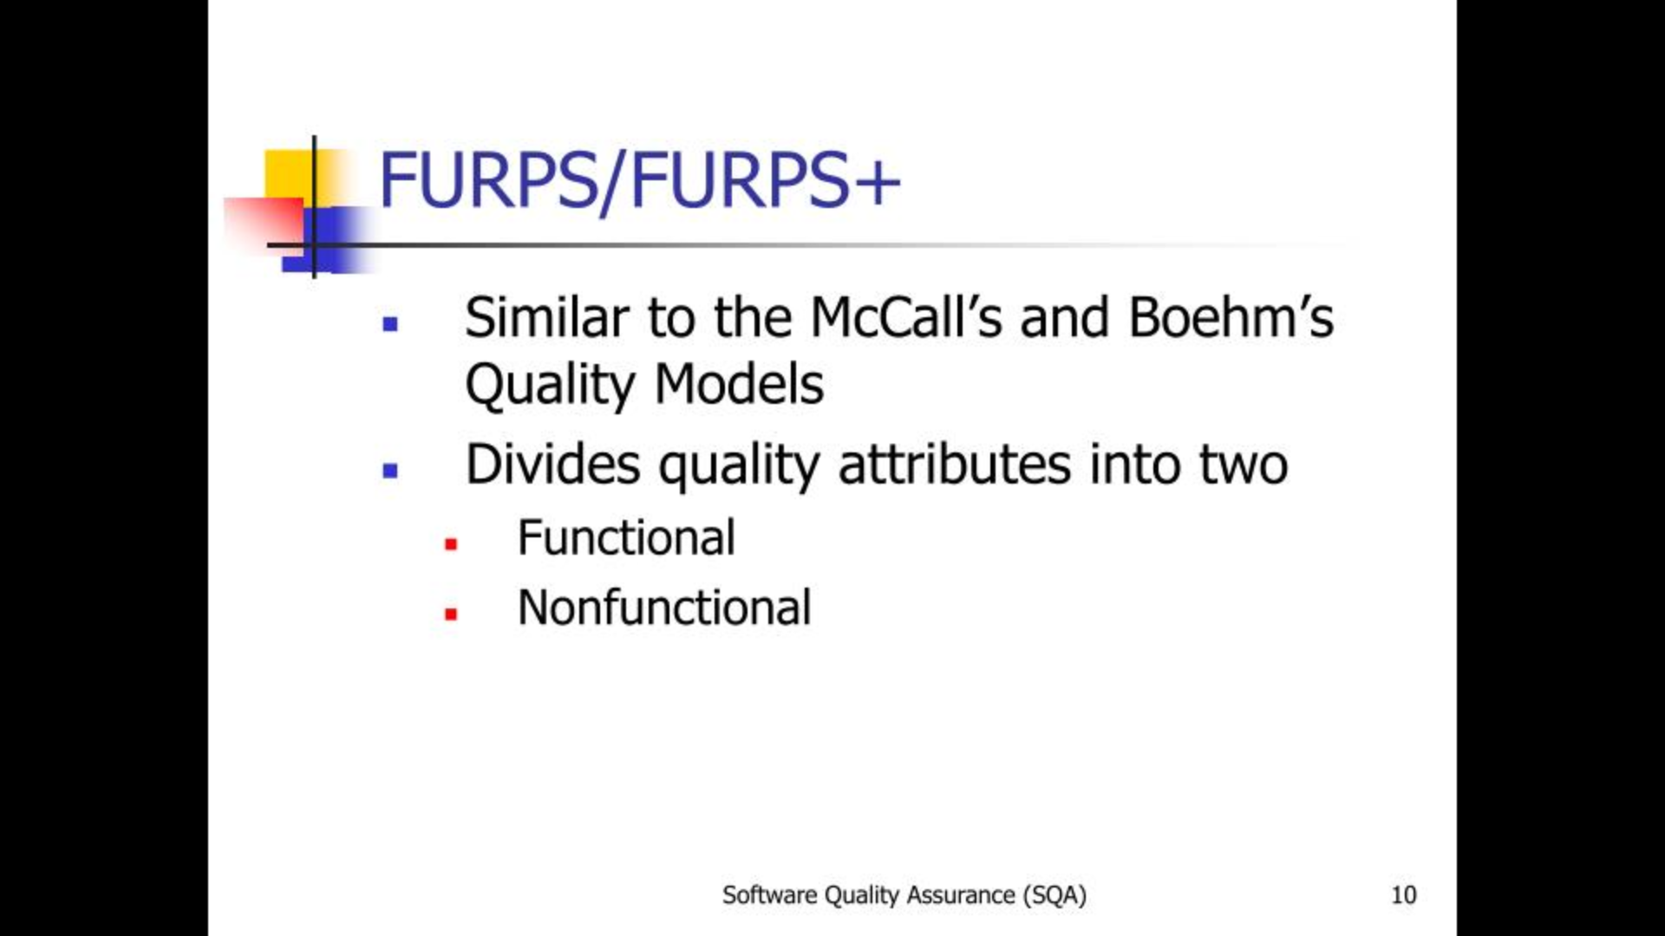

Slide 27
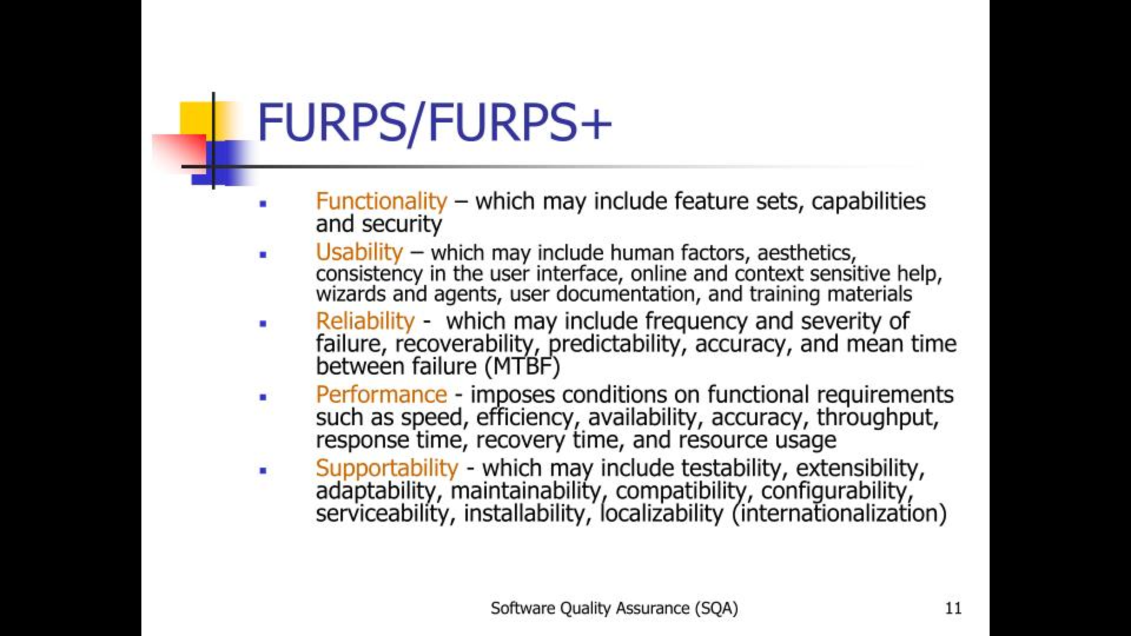

Slide 28
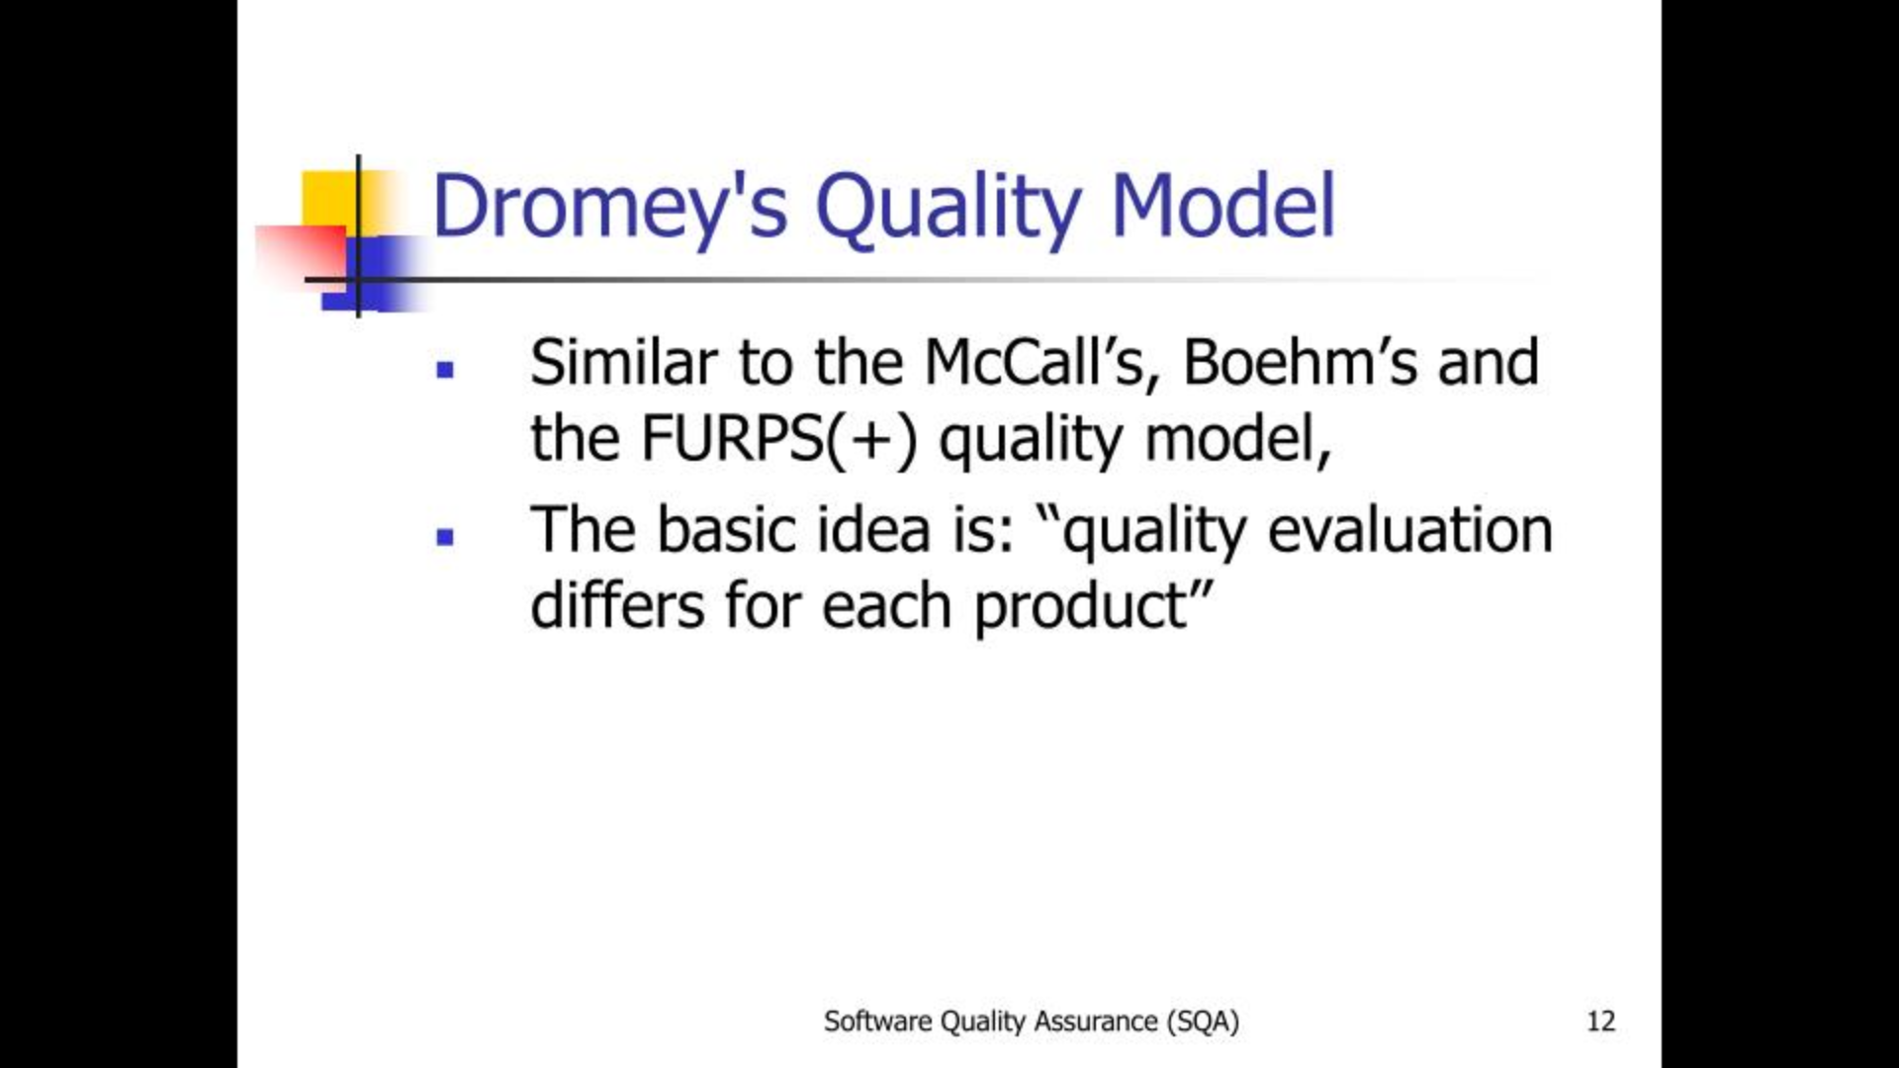

Slide 29
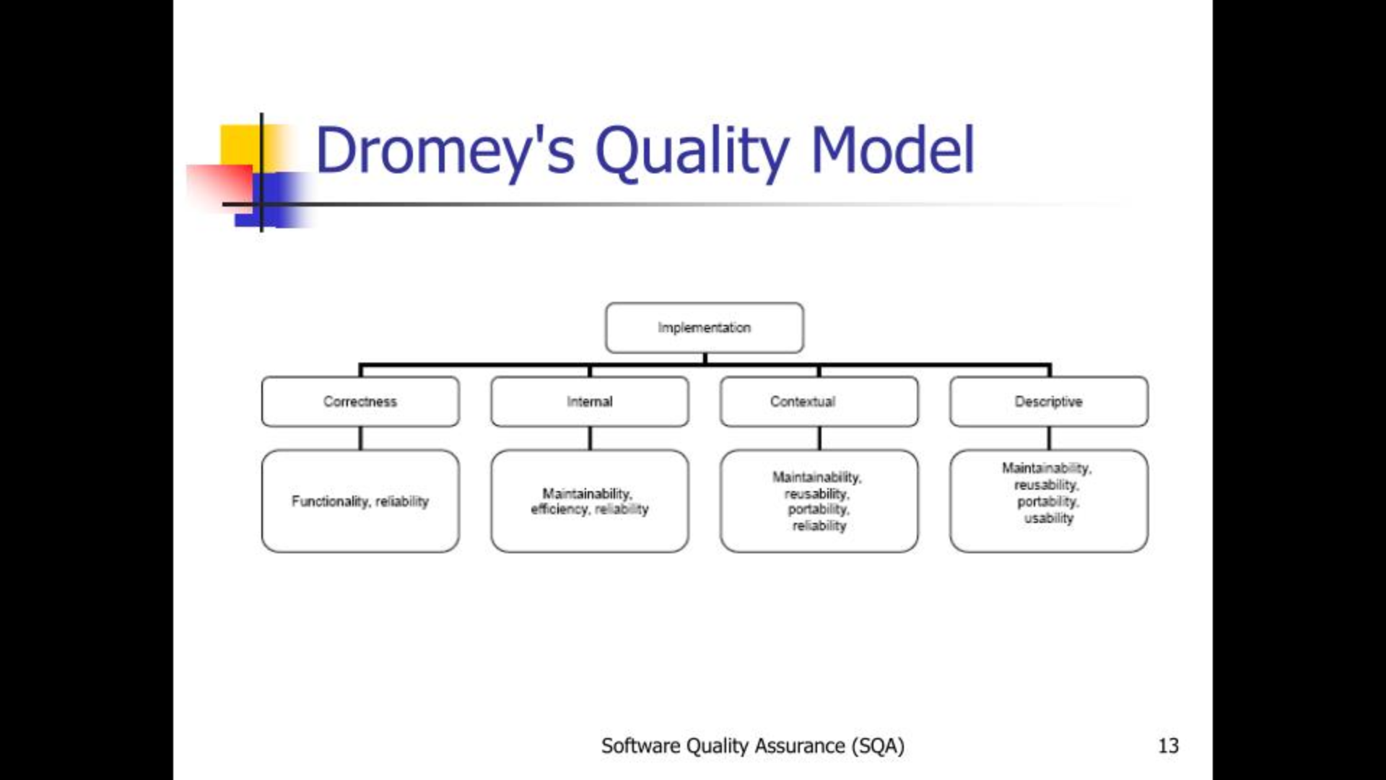

Slide 30
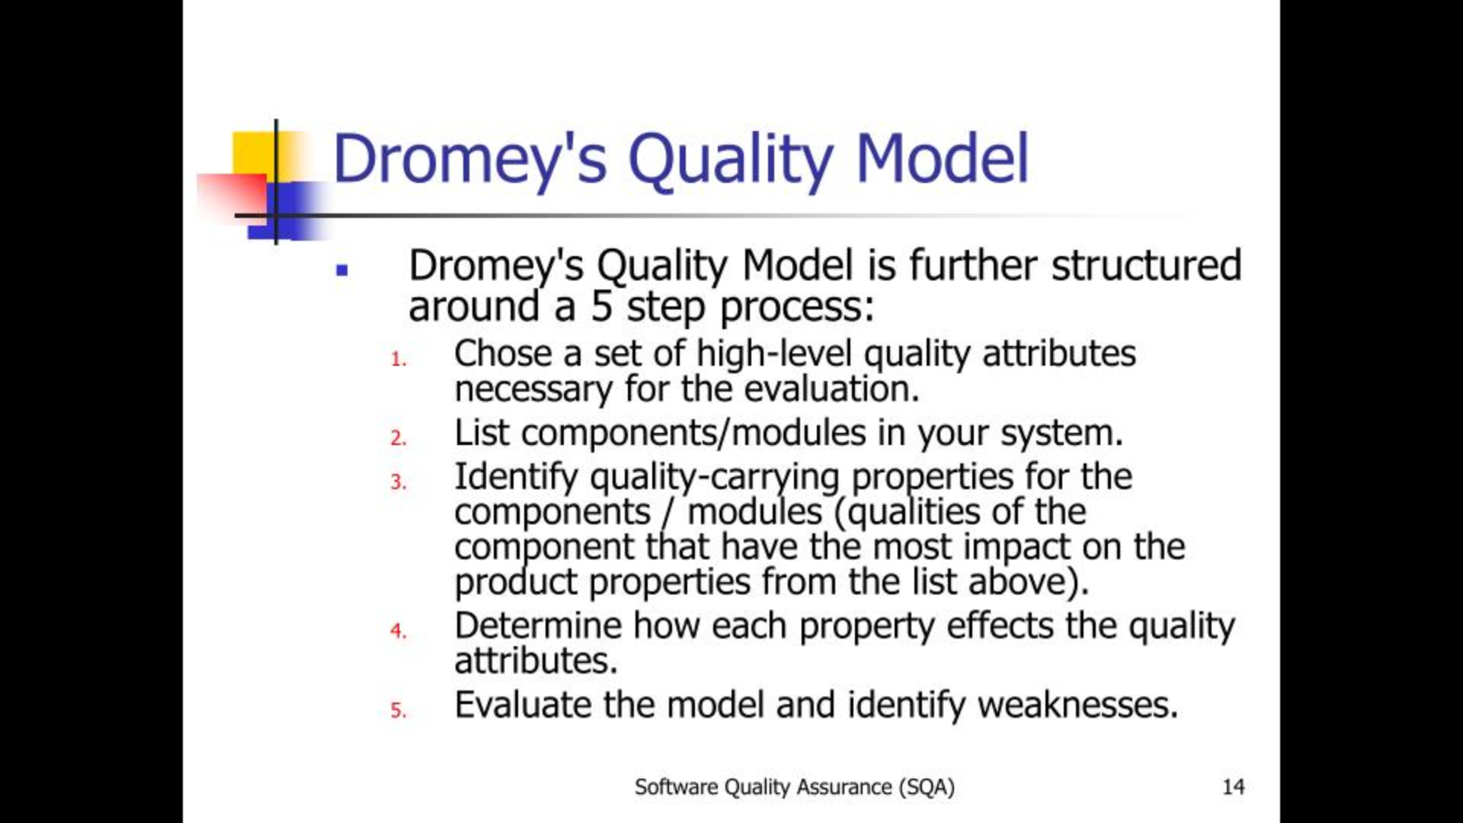

Slide 31
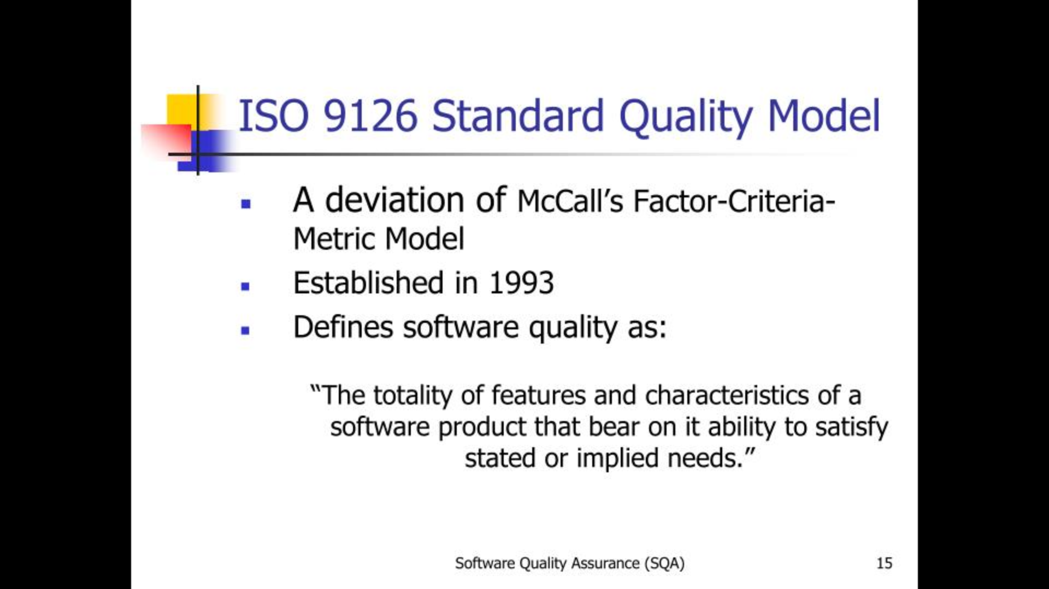

Slide 32
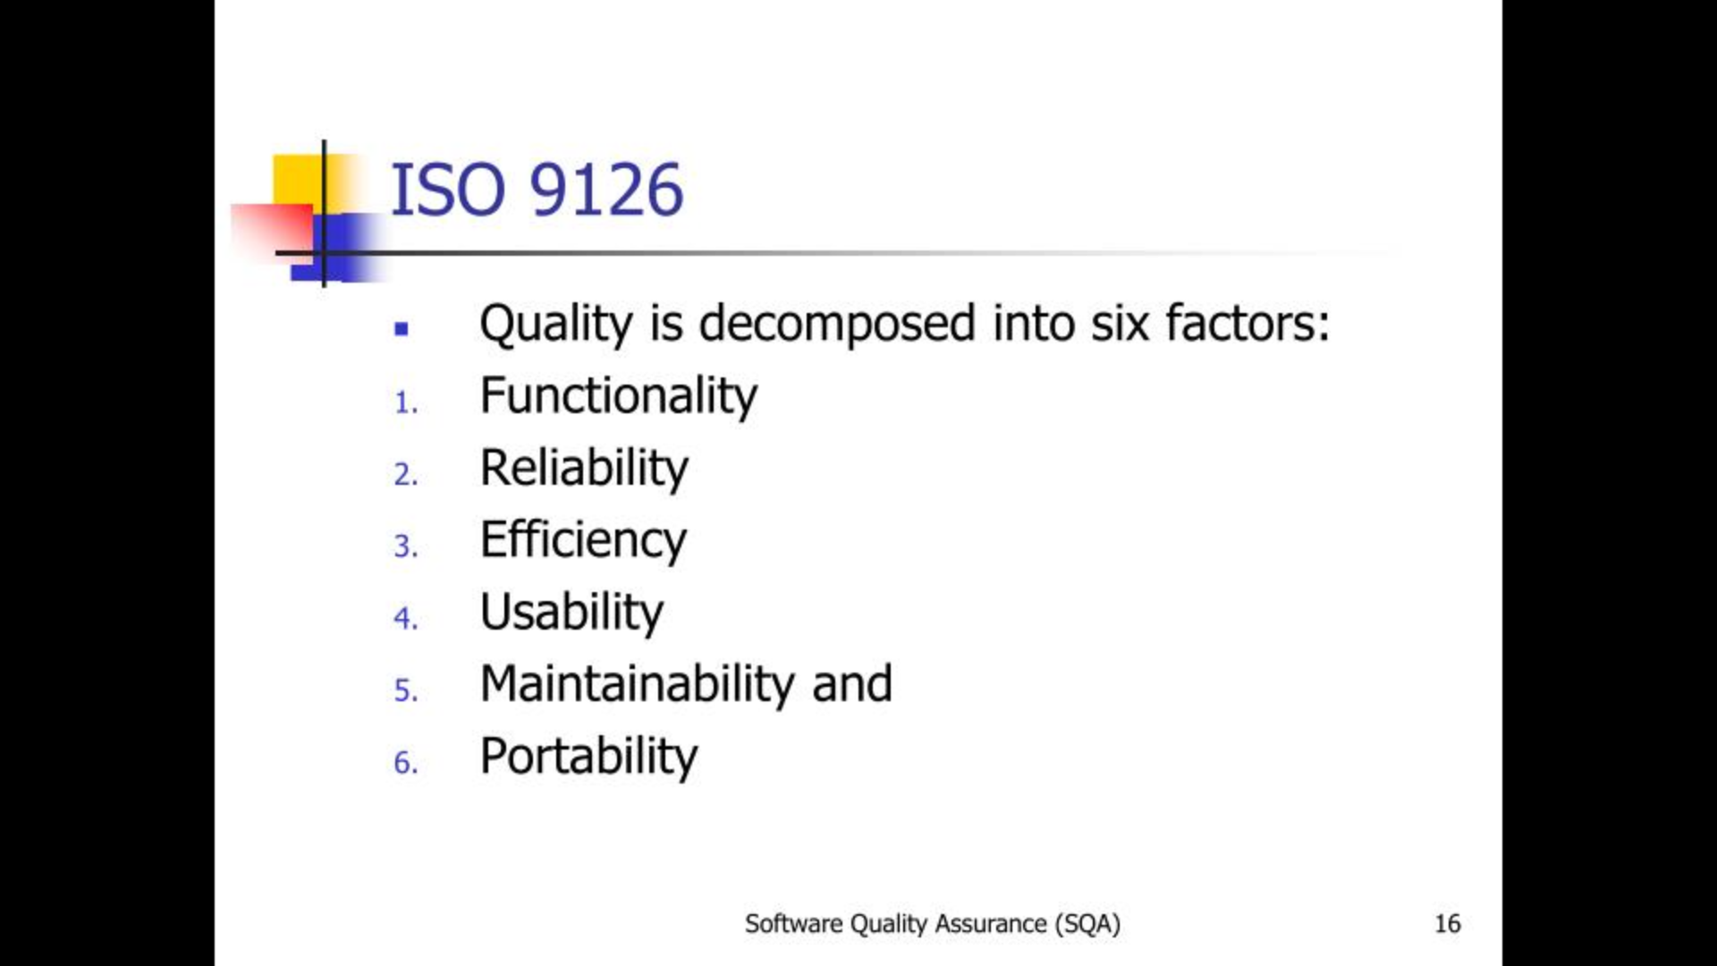

Slide 33
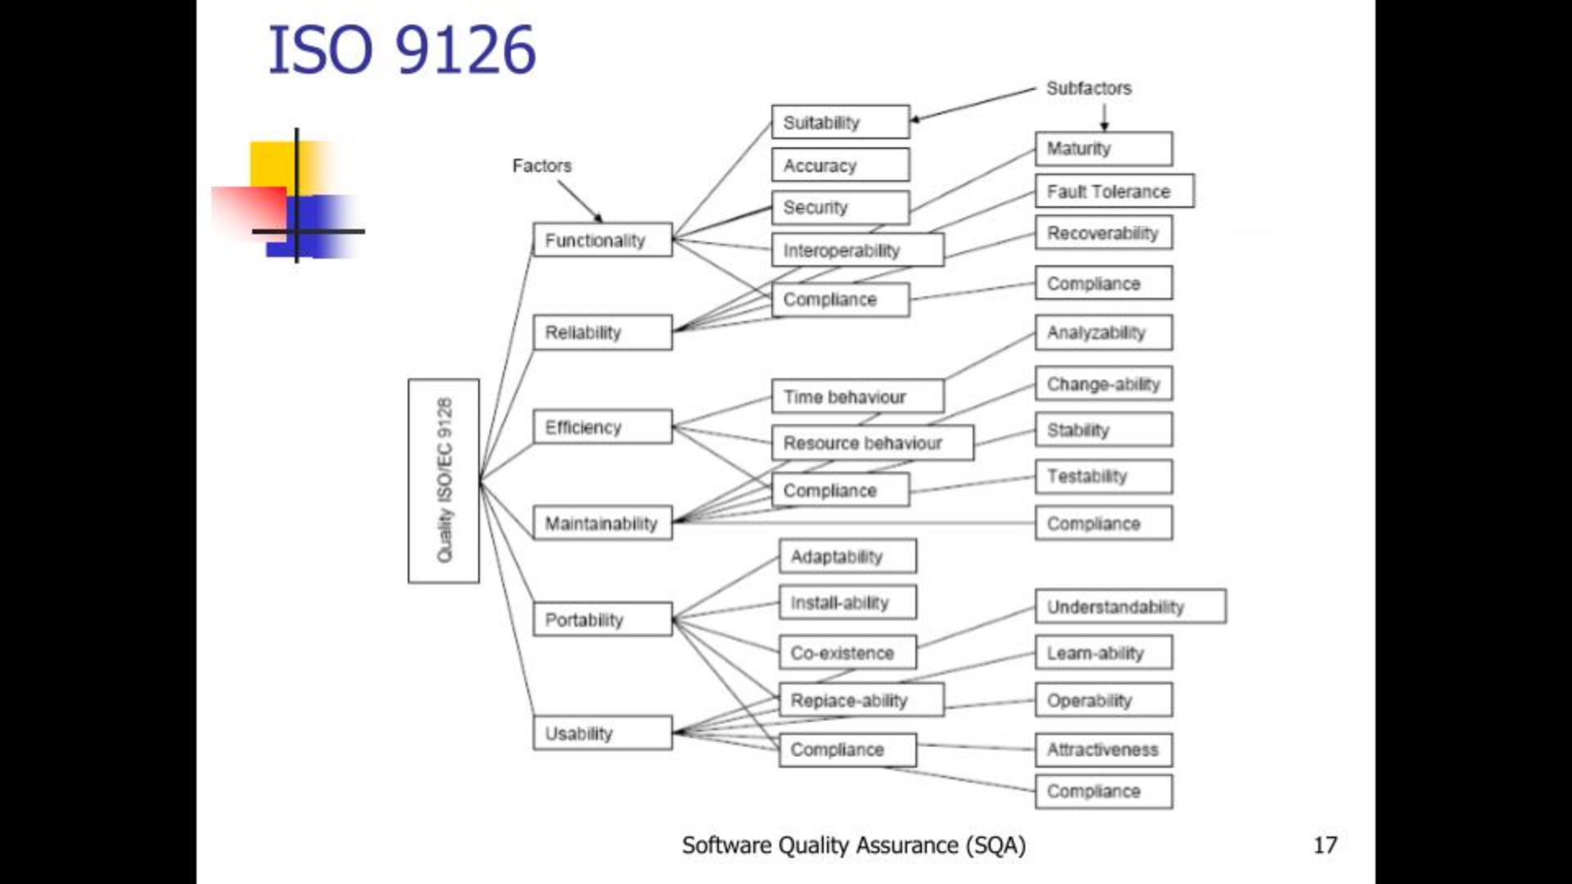

Slide 34
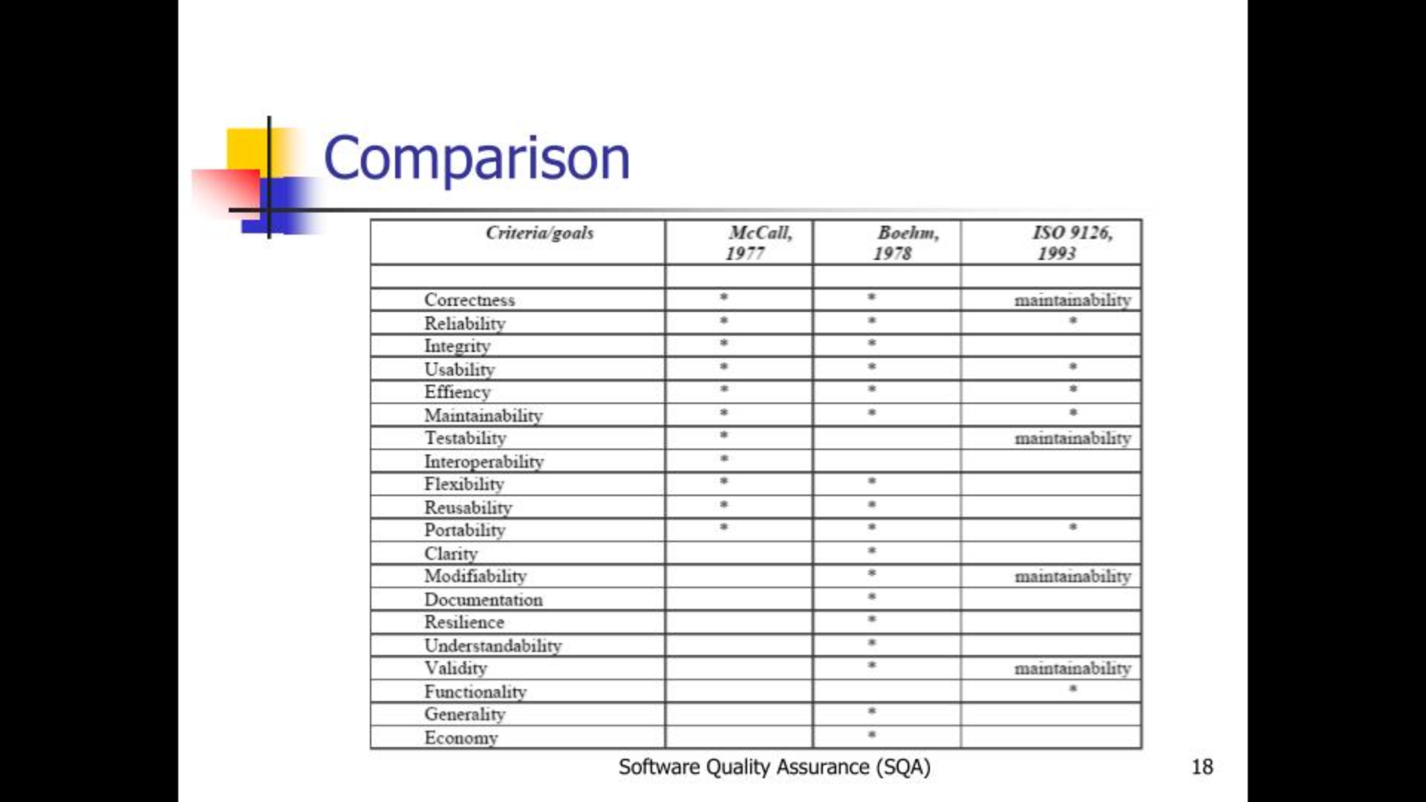

Slide 35
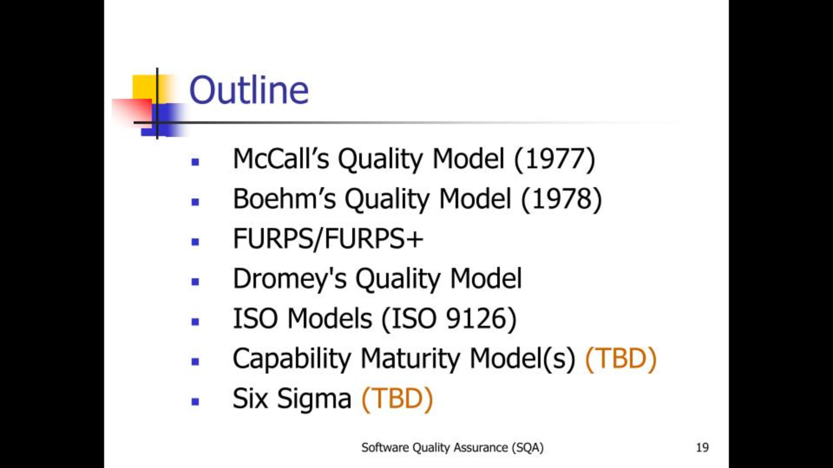

Slide 36
Introduction to Capability Maturity Models (CMM and CMMI);

Slide 37
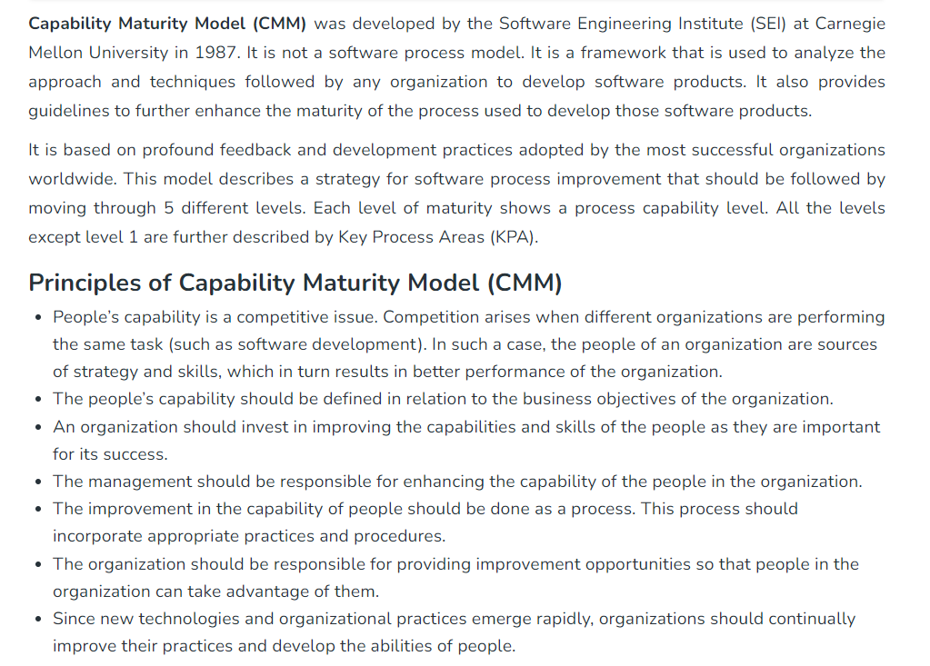

Slide 38
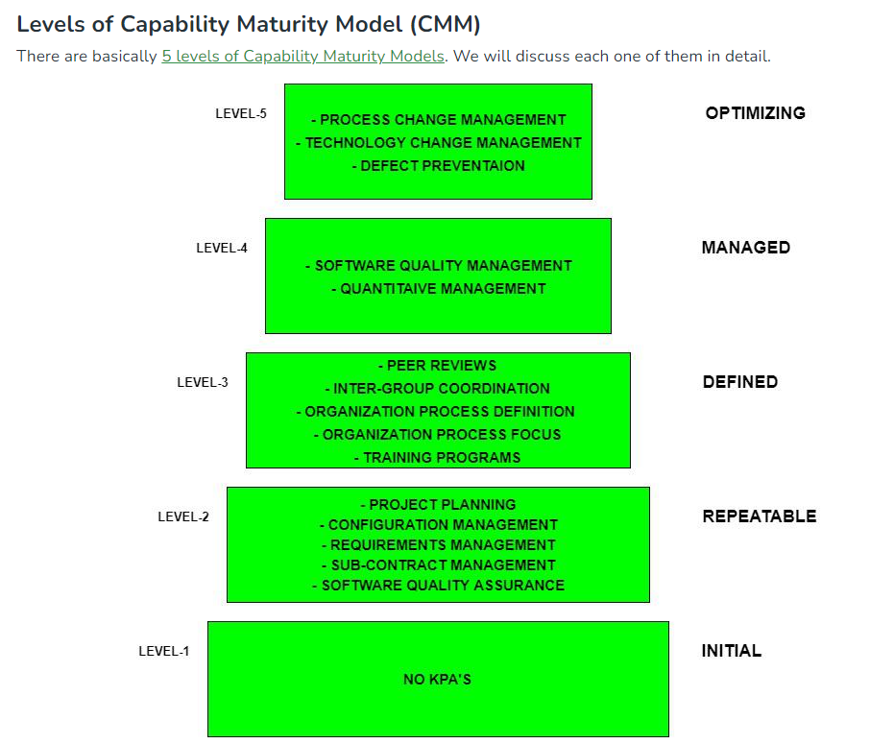

Slide 39
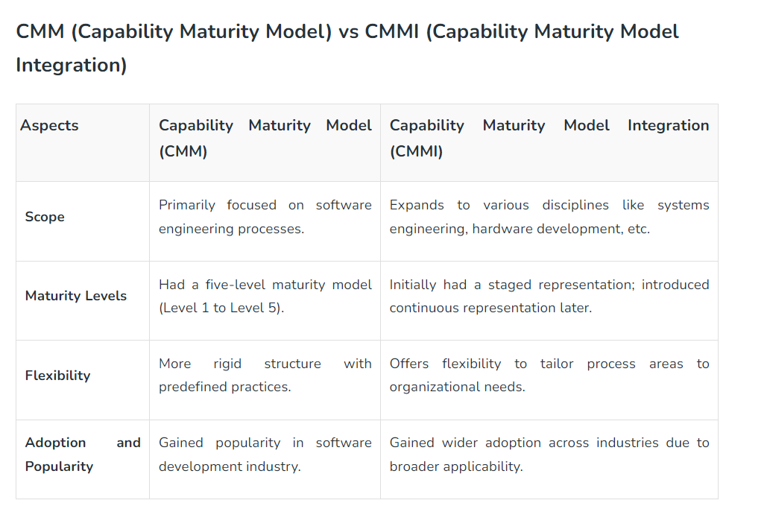

Slide 40
